Slide 1

计算机组成与系统结构 Computer Organization & System Architecture
Huang Kejie (黄科杰) 百人计划研究员
Office: 玉泉校区老生仪楼304
Email address: huangkejie@zju.edu.cn
HP: 17706443800

Slide 2
Sources of Cache Misses (3 C’s)
Compulsory (cold start, first reference):
1st access to a block, not a lot you can do about it
If running billions of instructions, compulsory misses are insignificant
misses that would occur even with infinite cache
Capacity:
cache is too small to hold all data needed by the program
Misses that would not occur with infinite cache
misses that would occur even under perfect replacement policy
Conflict (collision):
Misses that occur because of collisions due to line-placement strategy (multiple memory locations mapped to same cache set)
Misses that would not occur with ideal fully associative cache

Slide 3
How to Calculate 3C’s Using Cache Simulator
Compulsory: set cache size to infinity and fully associative, and count number of misses
Capacity: Change cache size from infinity, usually in powers of 2, and count misses for each reduction in size
16 MB, 8 MB, 4 MB, … 128 KB, 64 KB, 16 KB
Conflict: Change from fully associative to n-way set associative while counting misses
Fully associative, 16-way, 8-way, 4-way, 2-way, 1-way

Slide 4
Effect of Cache Parameters on Performance
Larger cache size
reduces capacity and conflict misses
hit time will increase
Higher associativity
reduces conflict misses
may increase hit time
Larger line size
reduces compulsory and capacity (reload) misses
increases conflict misses and miss penalty

Slide 5
Primary Cache Parameters
Block size
How many bytes of data in each cache entry?
Associativity
How many ways in each set?
Direct-mapped => Associativity = 1
Set-associative => 1 < Associativity < #Entries
Fully associative => Associativity = #Entries
Capacity (bytes) = Total #Entries * Block size
#Entries = #Sets * Associativity

Slide 6
Cache Design Space
Computer architects expend considerable effort optimizing organization of cache hierarchy – big impact on performance and power!
Several interacting dimensions
Cache size
Block size
Associativity
Replacement policy
Write-through vs. write-back
Write allocation
Optimal choice is a compromise
Depends on access characteristics
Workload
Use (I-cache, D-cache)
Depends on technology / cost
Simplicity often wins
Cache Size
Associativity
Block Size
Bad
Good
Factor A
Factor B
Less
More

Slide 7
Six Basic Cache Optimizations
Reduces compulsory misses
Increases capacity and conflict misses, increases miss penalty
Increases hit time, increases power consumption
Reduces conflict misses
Increases hit time, increases power consumption
Larger total cache capacity to reduce miss rate
Larger block size
Higher associativity
Reduces overall memory access time
Reduces miss penalty
Reduces hit time
Higher number of cache levels
Giving priority to read misses over writes
Avoiding address translation in cache indexing

Slide 8
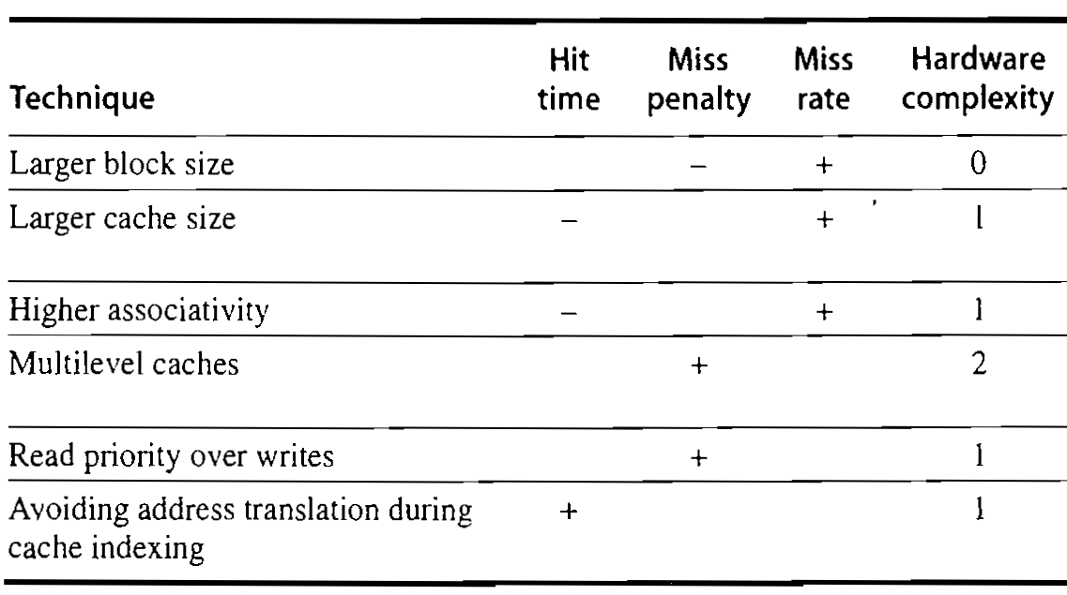
Impact of Cache Performance and Complexity

Slide 9
Impact of Larger Cache on AMAT?
1) Reduces misses (what kind(s)?)
2) Longer Access time (Hit time): smaller is faster
Increase in hit time will likely add another stage to the pipeline
At some point, increase in hit time for a larger cache may overcome improvement in hit rate, yielding a decrease in performance
Computer architects expend considerable effort optimizing organization of cache hierarchy – big impact on performance and power!

Slide 10
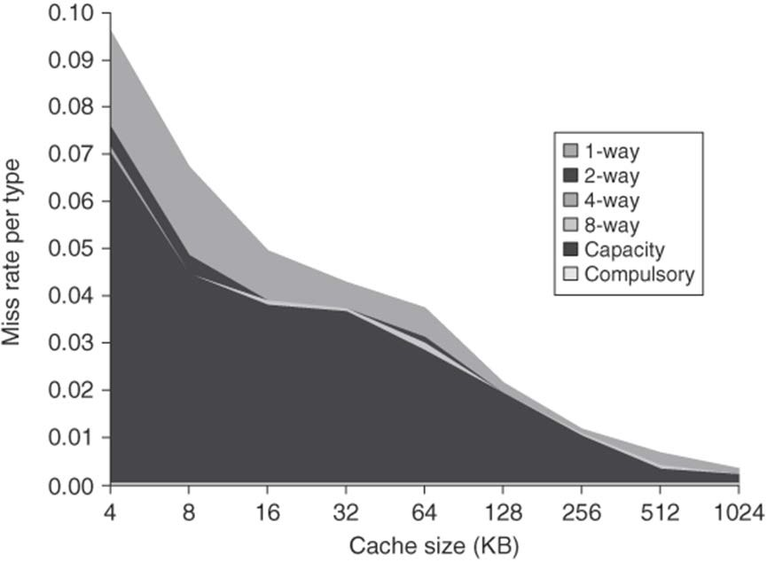
Larger Caches (Miss Rate↓)
Good for reducing capacity misses
Drawback: potentially longer hit time, and
higher cost and power
Popular in off-chip caches

Slide 11
Increasing Associativity?
Hit time as associativity increases?
Increases, with large step from direct-mapped to >=2 ways, as now need to mux correct way to processor
Smaller increases in hit time for further increases in associativity
Miss rate as associativity increases?
Goes down due to reduced conflict misses, but most gain is from 1->2->4-way with limited benefit from higher associativities
Miss penalty as associativity increases?
Unchanged, replacement policy runs in parallel with fetching missing line from memory

Slide 12
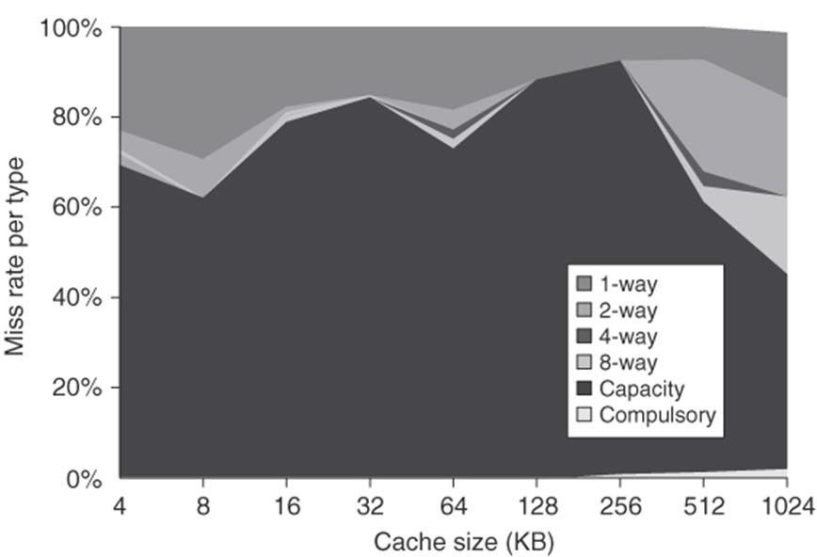
Higher Associativity (Miss Rate↓)
n-way cache, we increase n with a higher associativity, the cache has a smaller number of sets.
Total miss rate
Distribution of miss rate

Slide 13
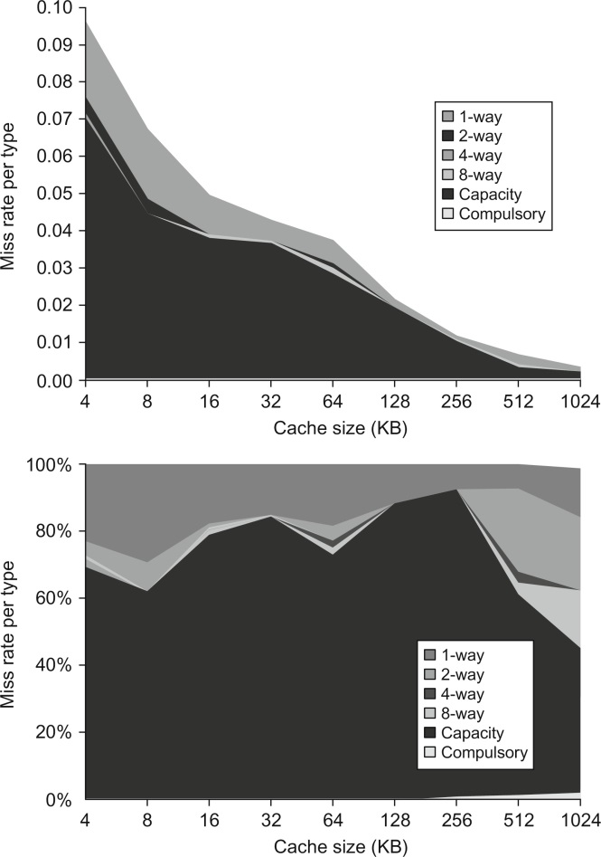
Figure B.9 Total miss rate (top) and distribution of miss rate (bottom) for each size cache according to the three C's for the data in Figure B.8. The top diagram shows the actual data cache miss rates, while the bottom diagram shows the percentage in each category. (Space allows the graphs to show one extra cache size than can fit in Figure B.8.)
© 2018 Elsevier Inc. All rights reserved.

Slide 14
Higher Associativity (cont’)
Two general rules of thumb
Eight-way set associative is for practical purposes as effective in reducing misses for these sized caches as fully associative
2:1 cache rule of thumb. A direct-mapped cache of size N has about the same miss rate as a two-way set associate cache of size N/2

Slide 15
Peer Instruction
For a cache of fixed capacity and block size, what is the impact of increasing associativity on AMAT:
A : Increases hit time, decreases miss rate
B : Decreases hit time, decreases miss rate
C : Increases hit time, increases miss rate
D : Decreases hit time, increases miss rate

Slide 16
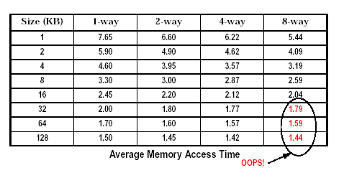
Average Memory Access Time
Higher associativity can reduce cache miss rates
Note that an 8-way set associative cache is essentially a fully-associative cache!
But, Greater associativity can cause increased hit time

Slide 17
Increasing Block Size?
Hit time as block size increases?
Hit time unchanged, but might be slight hit-time reduction as number of tags is reduced, so faster to access memory holding tags
Miss rate as block size increases?
Goes down at first due to spatial locality, then increases due to increased conflict misses due to fewer blocks in cache
Miss penalty as block size increases?
Rises with longer block size, but with fixed constant initial latency that is amortized over whole block

Slide 18
Recap: Line Size and Spatial Locality
A line is unit of transfer between the cache and memory
4 word line, b=2
Tag
Word0
Word1
Word2
Word3
Split CPU address
Line Address
Offset
32-b bits
b bits
2^{b} = line size a.k.a line size (in bytes)
Larger line size has distinct hardware advantages
less tag overhead
exploit fast burst transfers from DRAM
exploit fast burst transfers over wide busses
What are the disadvantages of increasing line size?
Fewer lines => more conflicts. Can waste bandwidth.

Slide 19
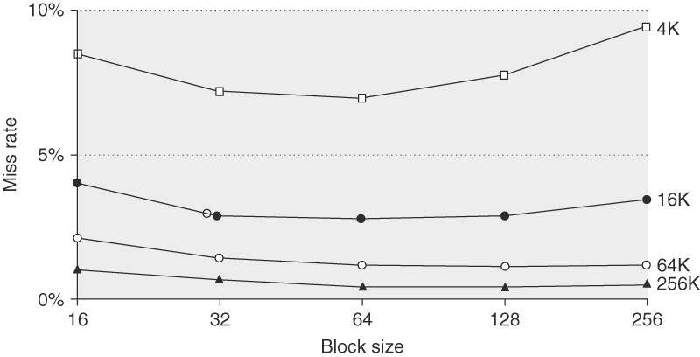
Larger Block Size (Miss Rate↓)
Reduce compulsory misses -> Principle of spatial locality
At the same time, may increase miss penalty, increase conflict misses

Slide 20
Peer Instruction
Impact of Larger Blocks on AMAT:
For fixed total cache capacity and associativity, what is effect of larger blocks on each component of AMAT:
A : Decrease
B : Unchanged
C : Increase
Hit Time? C: Unchanged (but slight increase possible)
Miss Rate? A: Decrease (spatial locality; conflict???)
Miss Penalty? C: Increase (longer time to load block)
Shorter tags +, mux at edge -
Write Allocation? It depends!

Slide 21
Peer Instruction
Impact of Larger Blocks on Misses:
For fixed total cache capacity and associativity, what is effect of larger blocks on each component of miss:
A : Decrease
B : Unchanged
C : Increase
Compulsory? A: Decrease (if good Spatial Locality)
Capacity? C: Increase (smaller blocks fit better)
Conflict? C: Increase (more ways better!)
Less effect for large caches

Slide 22
Increasing #Entries?
Hit time as #entries increases?
Increases, since reading tags and data from larger memory structures
Miss rate as #entries increases?
Goes down due to reduced capacity and conflict misses
Architects rule of thumb: miss rate drops ~2x for every ~4x increase in capacity (only a gross approximation)
Miss penalty as #entries increases?
Unchanged
At some point, increase in hit time for a larger cache may overcome the improvement in hit rate, yielding a decrease in performance

Slide 23

Giving Priority to Read misses (Penalty ↓)
without buffer with buffer
read read
cache
write buffer
write
read
stall
read
time
time
To serve reads before writes have been completed!

Slide 24


Avoiding Address Translations (Hit Time↓)
For each memory access, we need to check whether the data is in cache
To do the checking, we need to do two tasks,
Locating the possible data in cache ( by using the index)
Comparing the tags
VA
PA
miss
CPU
Trans- lation
Cache
Main Memory
hit
data
Cache with Virtual Address

Slide 25
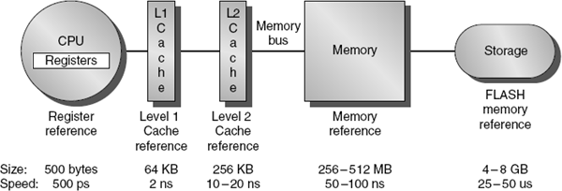
How to Reduce Miss Penalty?
Could there be locality on misses from a cache?
Use multiple cache levels!
With Moore’s Law, more room on die for bigger L1$ and for second-level L2$
And in some cases even an L3$!
Mainframes have ~1GB L4 cache off-chip

Slide 26
Local vs. Global Miss Rates
Local miss rate: fraction of references to a given level of a cache that miss
Local Miss rate L2$ = L2$ Misses / L1$ Misses = L2$ Misses / total_L2_accesses
Global miss rate: the fraction of references that miss in all levels of a multilevel cache and go all the way to memory
L2$ local miss rate >> than the global miss rate
Global Miss rate = L2$ Misses / Total Accesses
= (L2$ Misses / L1$ Misses) × (L1$ Misses / Total Accesses)
= Local Miss rate L2$ × Local Miss rate L1$
AMAT = Time for a hit + Miss rate × Miss penalty
AMAT = Time for a L1$ hit + (local) Miss rate L1$ × (Time for a L2$ hit + (local) Miss rate L2$ × L2$ Miss penalty)

Slide 27
Multilevel Cache AMAT Example
AMAT = T_{hit}(L1) + miss%(L1)×(T_{hit}(L2) + miss%(L2)×(T_{hit}(L3) + miss%(L3) ×T(memory) ) )
Example:
miss rate L1=10%, T_{hit}(L1) = 1 cycle
miss rate L2=5%, T_{hit}(L2) = 10 cycles
miss rate L3=1%, T_{hit}(L3) = 20 cycles
T(memory) = 300 cycles
AMAT = ?
2.115 (compare to 31 with no multi-levels)
14.7× speed-up!

Slide 28
Multilevel Cache Considerations
Different design considerations for L1$ and L2$
L1$ focuses on fast access: minimize hit time to achieve shorter clock cycle, e.g., smaller $
L2$, L3$ focus on low miss rate: reduce penalty of long main memory access times: e.g., Larger $ with larger block sizes/higher levels of associativity
Miss penalty of L1$ is significantly reduced by presence of L2$, so can be smaller/faster even with higher miss rate
For the L2$, fast hit time is less important than low miss rate
L2$ hit time determines L1$’s miss penalty
L2$ local miss rate >> than the global miss rate

Slide 29
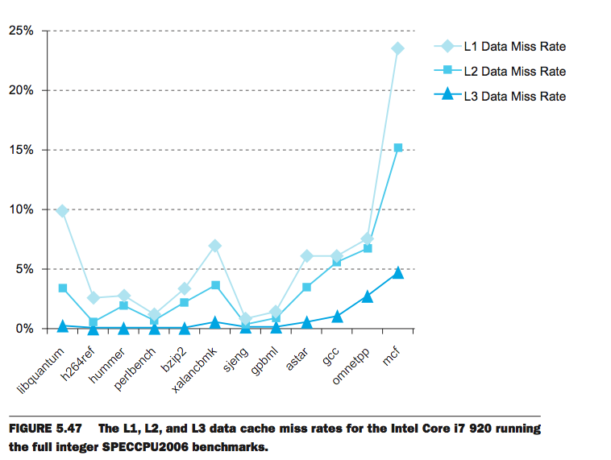
Multilevel Cache Considerations
L1 Cache: 32KB I$, 32KB D$
L2 Cache: 256 KB
L3 Cache: 4 MB
Cache Buster

Slide 30
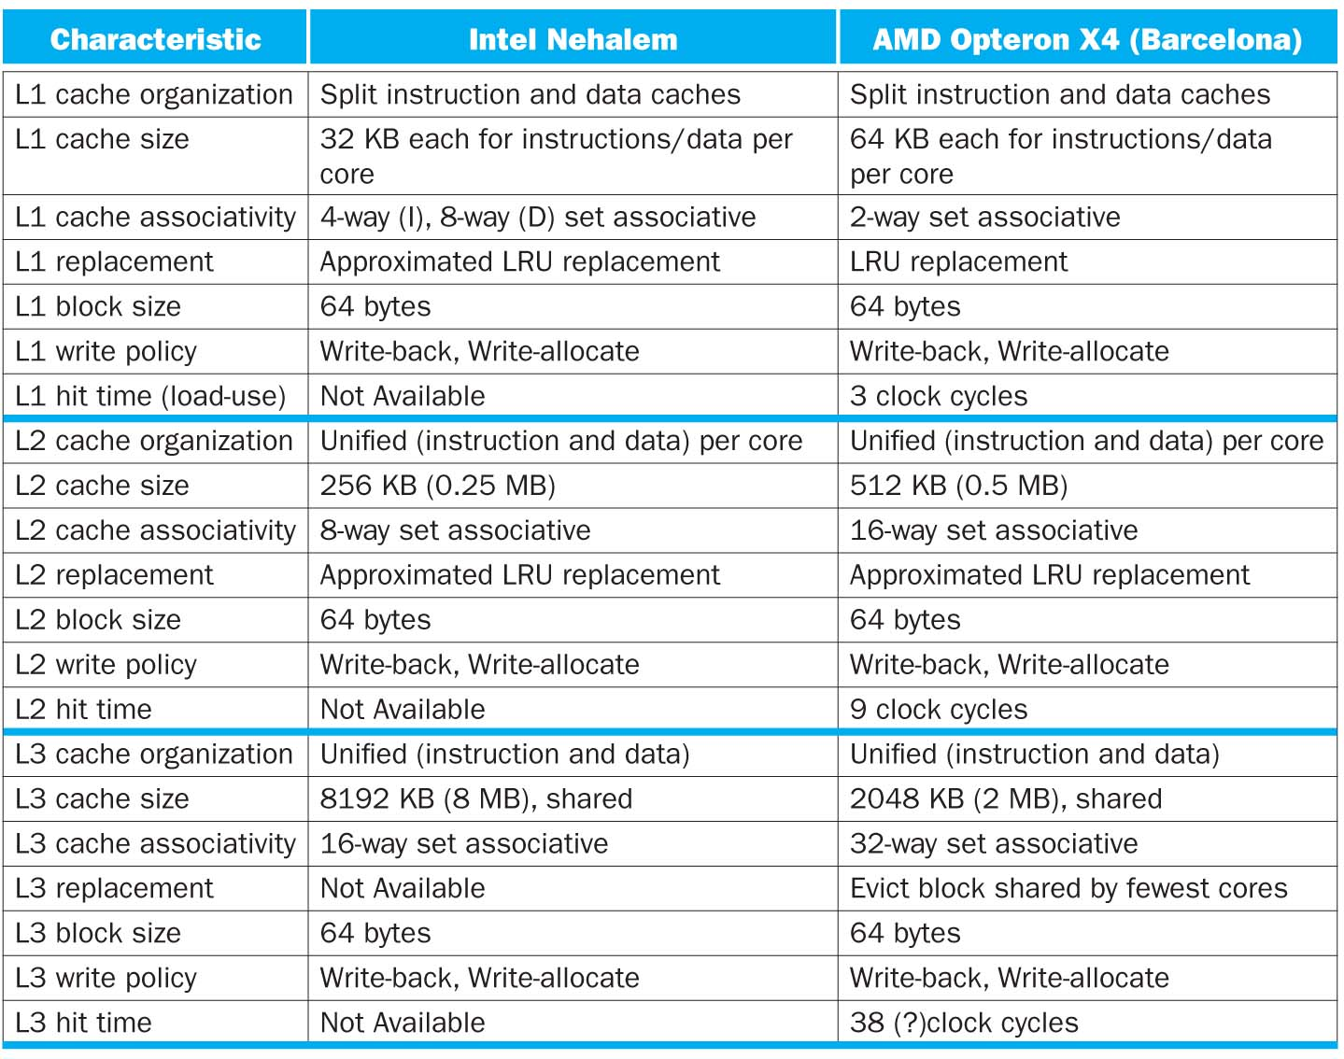
Multilevel Cache Considerations

Slide 31
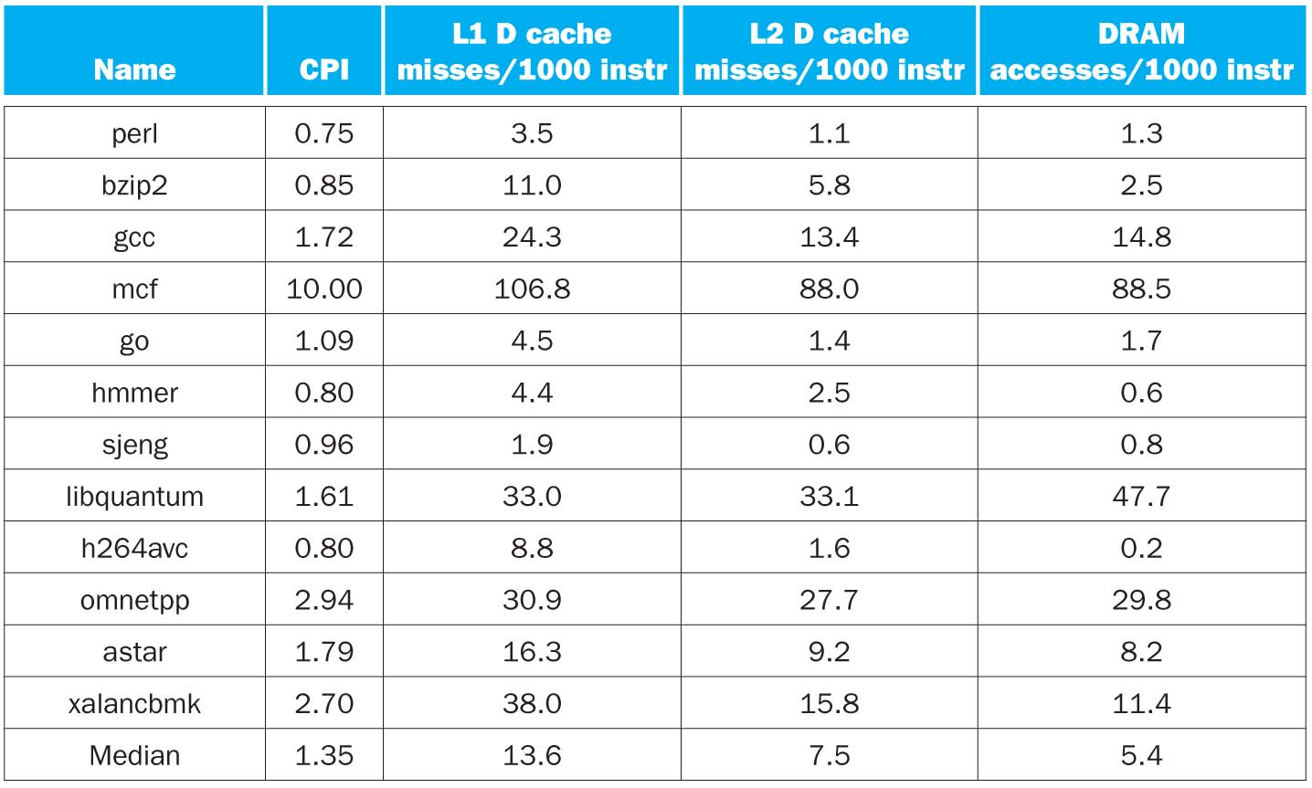
CPI/Miss Rates/DRAM Access SpecInt2006
Data Only
Data Only
Instructions and Data

Slide 32
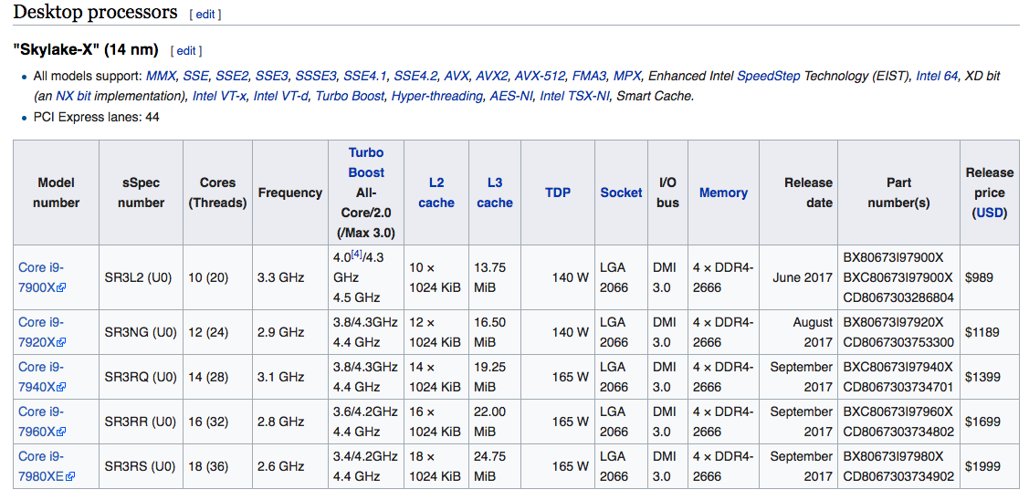
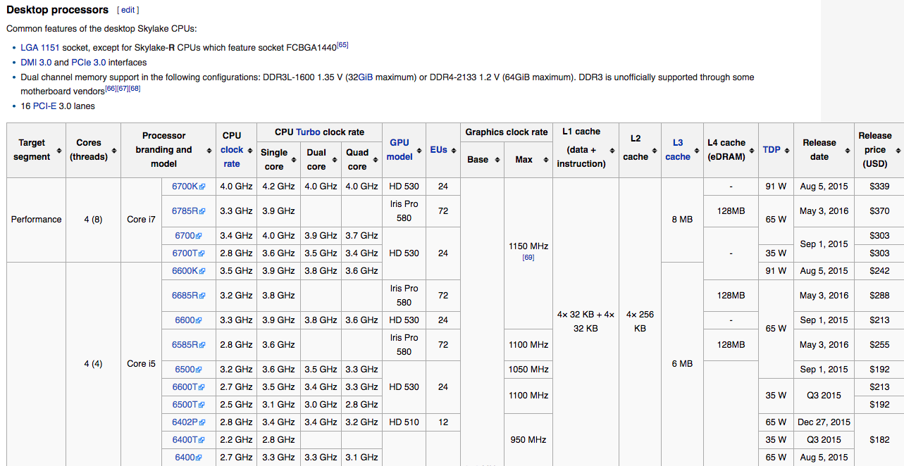
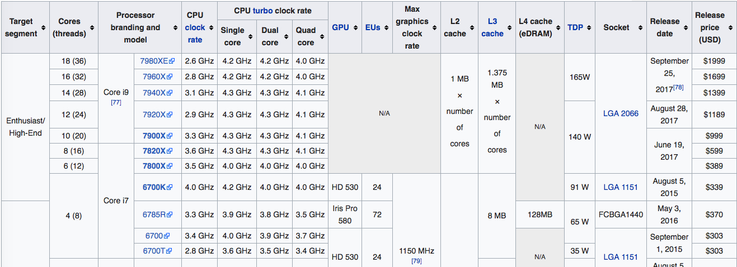
Skylark: Intel’s Recent Generation Laptop/Tablet Class CPUs

